Slide 1
Welcome
DATE
DATE
DATE
9 September 2011
DATE
DATE

Slide 2
DATE
DATE
DATE
9 September 2011
DATE
DATE
PLEASE REMEMBER
Enter quickly and quietly.
No food or drink allowed.
No headphones to be visible.
Uniform needs to be in order.
Get out all equipment needed.
Planners on desks.
Record date and lesson objectives.

Slide 3
DATE
DATE
DATE
9 September 2011
DATE
Learning Objective
To learn how POLYSEMIC SIGNS work together in complex media texts.
DATE
Learning Outcomes
All students will identify a range of signs in a film poster.
Most students will be able to identify the three different types of sign at work.
Some students will explore the meanings that the signs create and how they work together to make sense to the audience.

Slide 4
DATE
DATE
DATE
9 September 2011
STARTER
DATE
RECAP
What is a SIGN?
How does it create meaning?
What are the three TYPES OF SIGN?
DATE

Slide 5
DATE
DATE
DATE
9 September 2011
EXPLODING MEANINGS
DATE
Part of the difficulty of studying how we read pictures is that you as an audience do it naturally and quickly every day.
As media students we need to be able to make this process clearer so that we can explain and analyse HOW this process works.
DATE

Slide 6
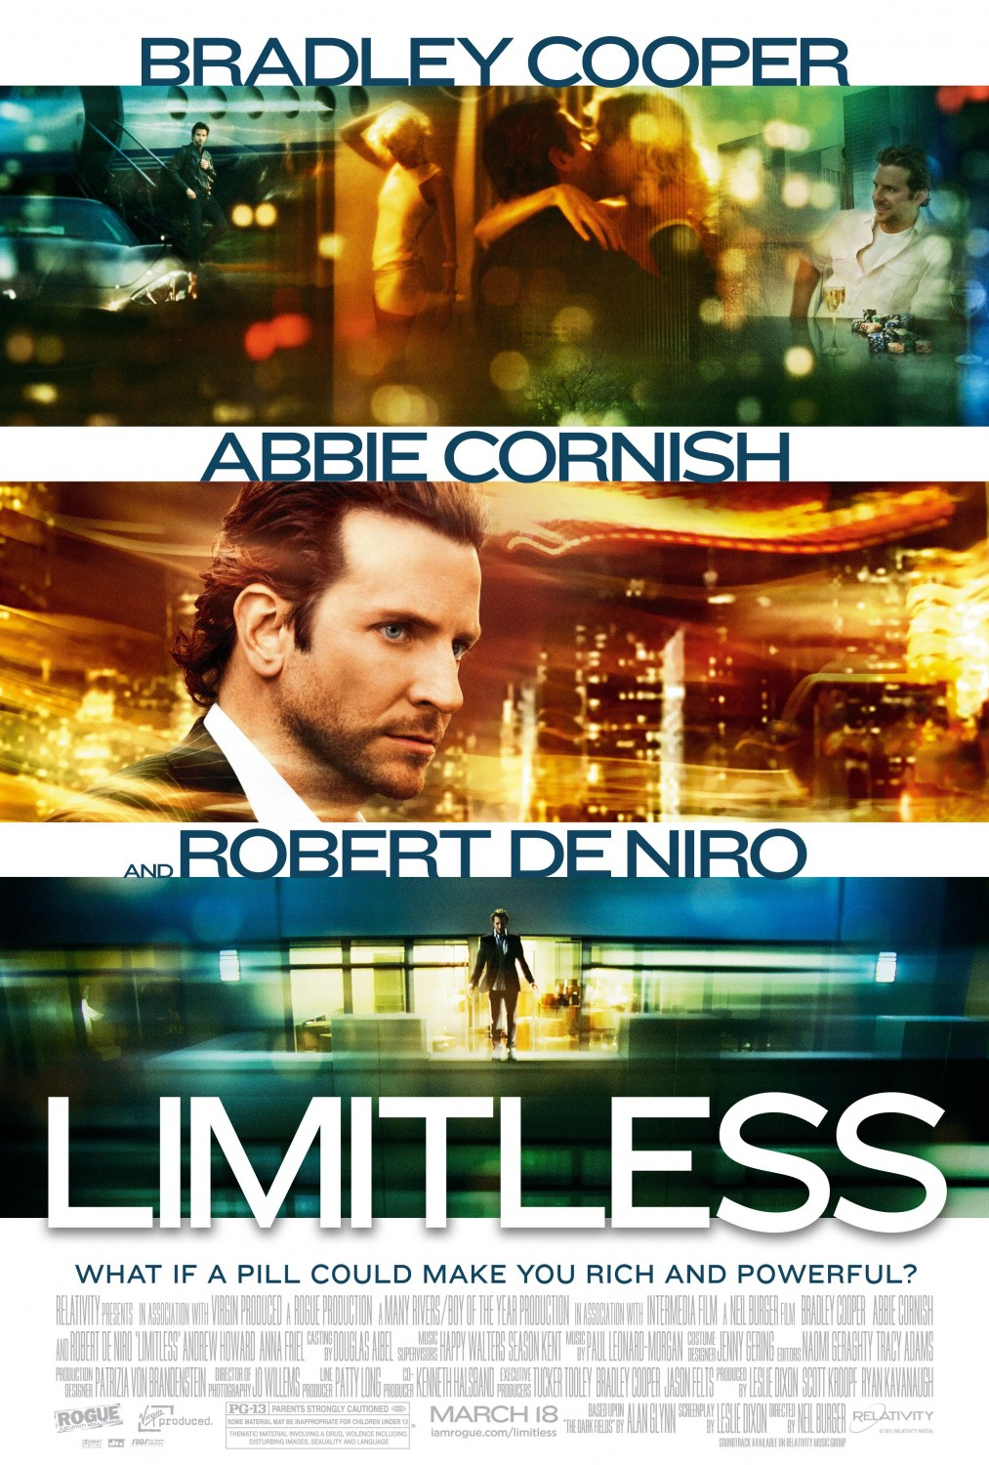
DATE
DATE
DATE
9 September 2011
DATE
DATE
EXPLODING MEANINGS
What can you tell me about this film from the images in the poster?

Slide 7
DATE
DATE
DATE
EXPLODING MEANINGS
9 September 2011
DATE
DATE
STEP 1
Identify a range of SIGNS in the poster and label them.

Slide 8
DATE
DATE
DATE
EXPLODING MEANINGS
9 September 2011
DATE
Kiss
DATE
Night
City
STEP 1
Identify a range of SIGNS in the poster and label them.
Suit
Motion Blur
“Rich”
“Pill”

Slide 9
DATE
DATE
DATE
EXPLODING MEANINGS
9 September 2011
DATE
Kiss
DATE
Night
City
STEP 2
Identify what type of SIGN each of them belong to.
Suit
Motion Blur
“Rich”
“Pill”

Slide 10
DATE
DATE
DATE
EXPLODING MEANINGS
9 September 2011
DATE
Kiss
INDEXICAL SIGN
DATE
Night
ICONIC SIGN
City
ICONIC SIGN
STEP 2
Identify what type of SIGN each of them belong to.
Suit
ICONIC SIGN
Motion Blur
INDEXICAL SIGN
“Rich”
SYMBOLIC SIGN
“Pill”
SYMBOLIC SIGN

Slide 11
DATE
DATE
DATE
EXPLODING MEANINGS
9 September 2011
DATE
Kiss
INDEXICAL SIGN
DATE
Night
ICONIC SIGN
STEP 3
Identify what meanings could be attached to them.
City
ICONIC SIGN
Suit
ICONIC SIGN
Motion Blur
INDEXICAL SIGN
“Rich”
SYMBOLIC SIGN
“Pill”
SYMBOLIC SIGN

Slide 12
DATE
DATE
Kiss
INDEXICAL SIGN
Romance
Affection
Close
Greeting
Passion
Farewell
DATE
EXPLODING MEANINGS
Night
ICONIC SIGN
Danger
Sleep
Hidden
Secret
Dreams
Nightmare
9 September 2011
DATE
DATE
City
ICONIC SIGN
Buildings
Busy
People
Rich
Power
Motion Blur
INDEXICAL SIGN
Speed
Flight
SFX
STEP 3
Identify what meanings could be attached to them.
“Pill”
SYMBOLIC SIGN
Science
Medicine
Illness
Easy Fix
Suit
ICONIC SIGN
Masculine
Power
Smart
Serious
“Rich”
SYMBOLIC SIGN
Powerful
Successful
Glamourous
Desirable

Slide 13
DATE
DATE
DATE
9 September 2011
TASK
DATE
EXPLODING MEANINGS
DATE
Work in pairs to go through the three steps with the film poster that you have been given to create a poster for display that explodes the meanings of the poster.
Be creative with colour, layout and presentation.

Slide 14
DATE
DATE
DATE
9 September 2011
DATE
PLENARY
DATE
Home Learning:
Complete your poster EXPLODING MEANINGS for Friday 16th September.
How do the SIGNS that you have identified so far work together to tell you about the film?

