Slide 1
Welcome
DATE
DATE
DATE
14 February 2014
DATE
DATE

Slide 2
DATE
DATE
DATE
14 February 2014
DATE
DATE
PLEASE REMEMBER
Enter quickly and quietly.
No food or drink allowed.
No headphones to be visible.
Get out all equipment needed.

Slide 3
DATE
DATE
DATE
14 February 2014
DATE
Learning Objective
To understand the theory of REPRESENTATION.
DATE
Learning Outcomes
All students will consider how media texts shape our view of the world.
Most students will consider how REPRESENTATIONS are formed.
Some students will apply these ideas to media texts.

Slide 4
DATE
DATE
DATE
14 February 2014
DATE
NATURE VS. NURTURE?
DATE
Write a toy on a post-it note – any toy.
Place it somewhere on a scale from Masculine to Feminine – be prepared to explain why you consider it to be there.
Use the other toys on the scale to decide where yours should be.
Notes:
HOME LEARNING = Monday

Slide 5
DATE
DATE
DATE
14 February 2014
DATE
NATURE VS. NURTURE?
DATE
Write a occupation on a post-it note.
Place it somewhere on a scale from Masculine to Feminine – be prepared to explain why you consider it to be there.
Use the other toys on the scale to decide where yours should be.
Notes:
HOME LEARNING = Monday

Slide 6
DATE
DATE
DATE
14 February 2014
DATE
NATURE VS. NURTURE?
DATE
To what extent do you think that the position that you have placed your toy and occupation is down to natural differences between men and women and which are because of social factors and the way that society nurtures us?
Notes:
HOME LEARNING = Monday

Slide 7
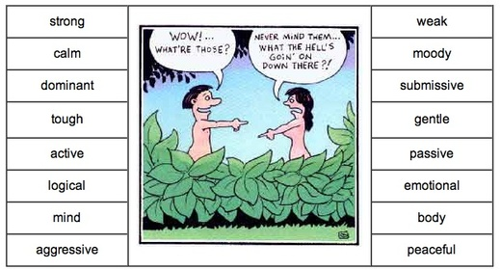
DATE
DATE
DATE
14 February 2014
DATE
Men Vs. Women
DATE
Notes:
HOME LEARNING = Monday

Slide 8
DATE
DATE
DATE
14 February 2014
DATE
Men Vs. Women
DATE
Between these two terms which is the most positive?
Notes:
HOME LEARNING = Monday

Slide 9
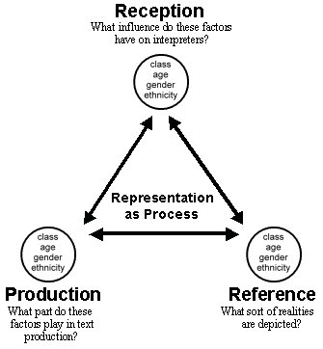
DATE
DATE
DATE
14 February 2014
Representation
DATE
DATE

Slide 10
DATE
DATE
DATE
14 February 2014
Representation
DATE
Personal Codes
Performance Codes
What do they look like?
Hair
Clothes
Make-up
What are they doing?
Actions
Expressions
Technical Codes
How are they filmed?
Angles
Shots
Lighting
Editing
Narrative Codes
What roles do they play in the story?
Hero
Villain
Victim
To form a representation we look at:
DATE

Slide 11
DATE
DATE
DATE
14 February 2014
Representation
DATE
Stereotypes
Media Institutions use stereotypes because the audience will instantly understand them. Think of stereotypes as a ‘visual shortcut’. They’re repeated so often that we assume they are normal or ‘true’.
Can you think of any STEREOTYPES of:
Teenagers?
Old People?
Men?
Women?
DATE

Slide 12
DATE
DATE
DATE
14 February 2014
Representation
DATE
Archetypes
This is the ‘ultimate’ stereotype. For example, the white stiletto wearing, big busted, brainless blonde bimbo.
Can you think of any ARCHETYPES?
ARCHETYPES often form the basis of other character types e.g. is there an ARCHETYPAL villain?
DATE

Slide 13
DATE
DATE
DATE
14 February 2014
Representation
DATE
Countertype
A representation that challenges tradition stereotypical associations of groups, people or places.
Can you think of any REPRESENTATIONS that challenge the usual view of gender?
DATE

